Slide 1
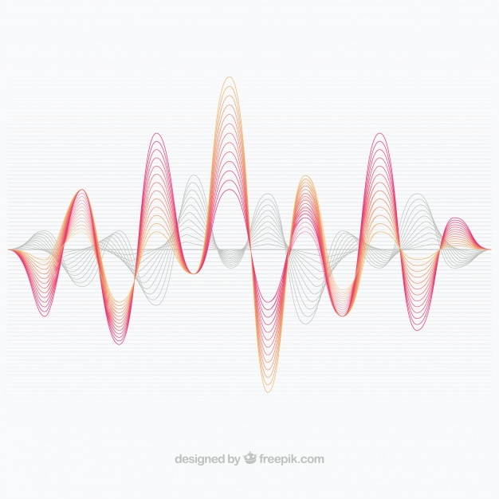
ULTRASONIC SENSOR

Slide 2
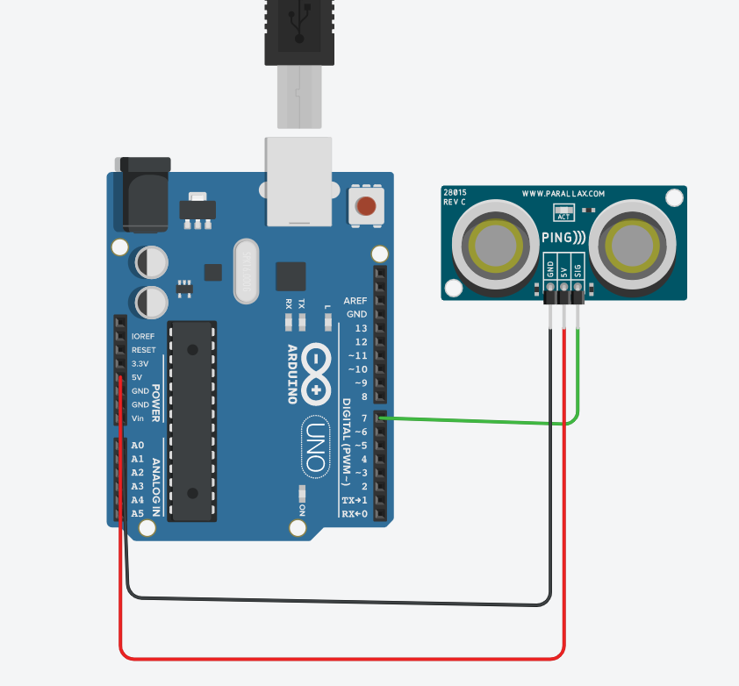
Circuit Diagram

Slide 3
Architecture And functionality
Architecture
This Ultrasonic Sensor Circuit consists of a set of ultrasonic receiver and transmitter which operate at the same frequency.
Functionality
Ultrasonic Sensor is used to measure the distance b/w the obstacle and the ultrasonic sensor with the help of soundwaves.

Slide 4
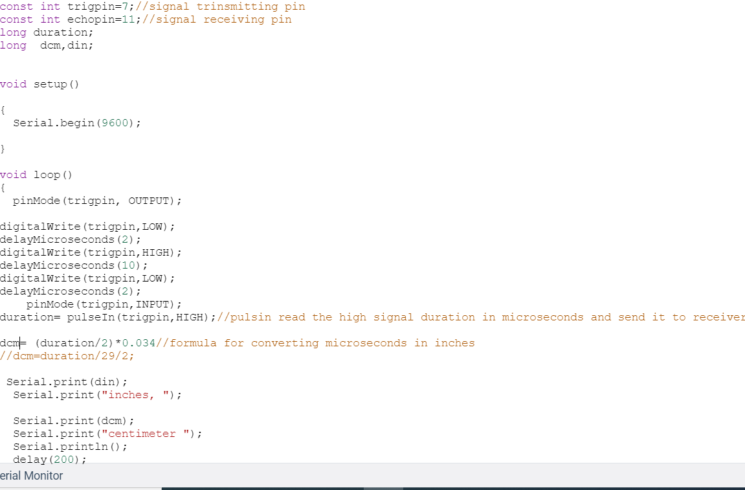
Time Conversion
Speed of sound
C = 340m/s
C = 340*100cm/10^6uS
C = 0.034cm/uS
Distance in Cm
Distance= d= (Duration)/*c

